Slide 1
Developmental assessment
Becky Ollerenshaw

Slide 2
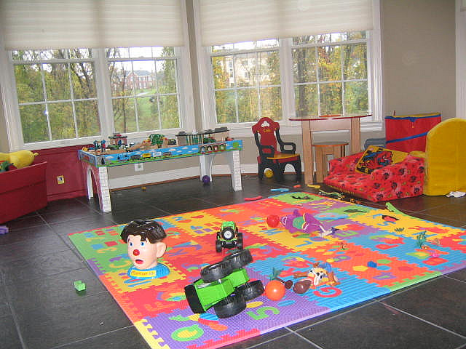
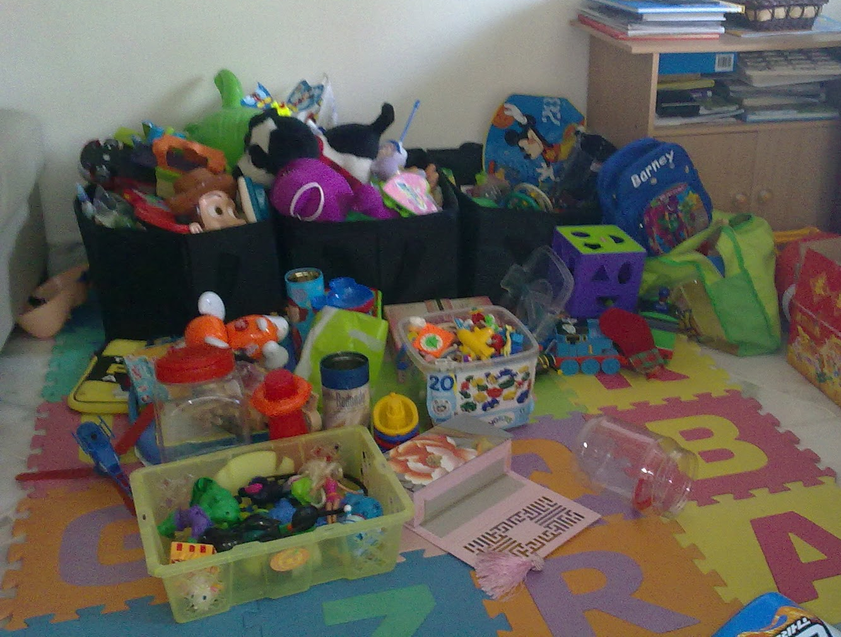
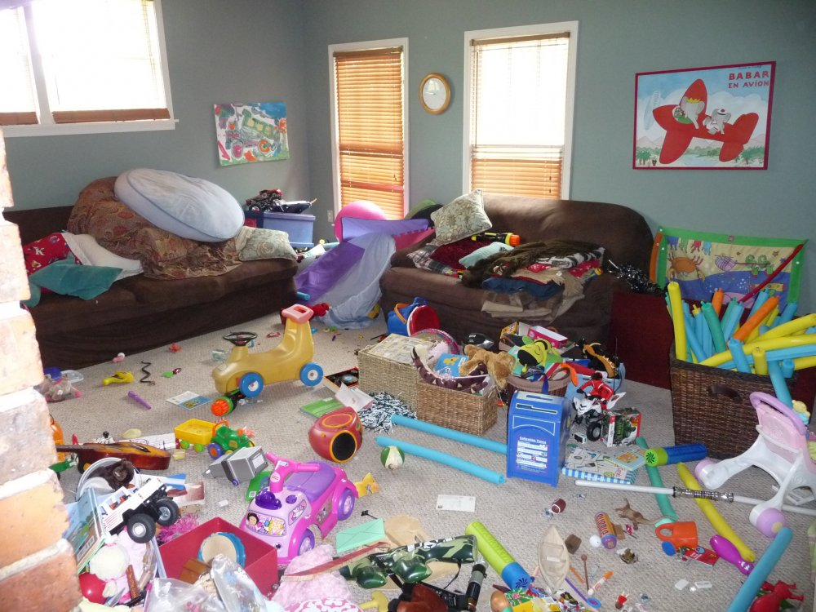
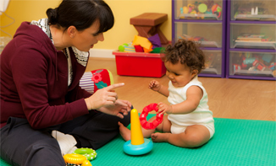
Now to the fun bit!!

Slide 3
Four main areas
Gross motor
Fine motor and vision
Hearing, Speech and Language
Social, Emotional and Behavioural

Slide 4
Two measures
Average age of acquisition
Most children will be able to do this skill by this age
Used to estimate the child’s developmental age
Age of concern
The latest age a normally developing child would acquire this skill
Referral by GP for developmental assessment

Slide 5
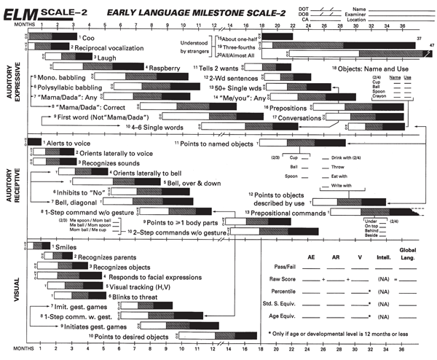

Slide 6
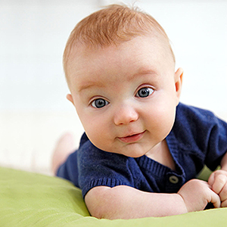
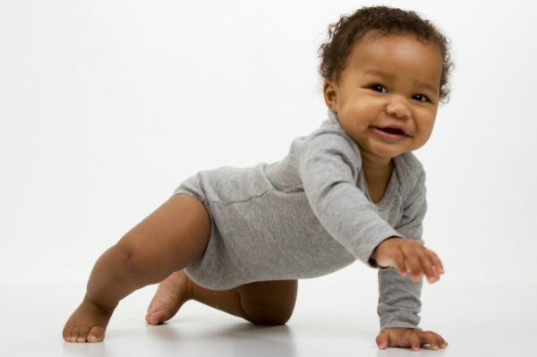
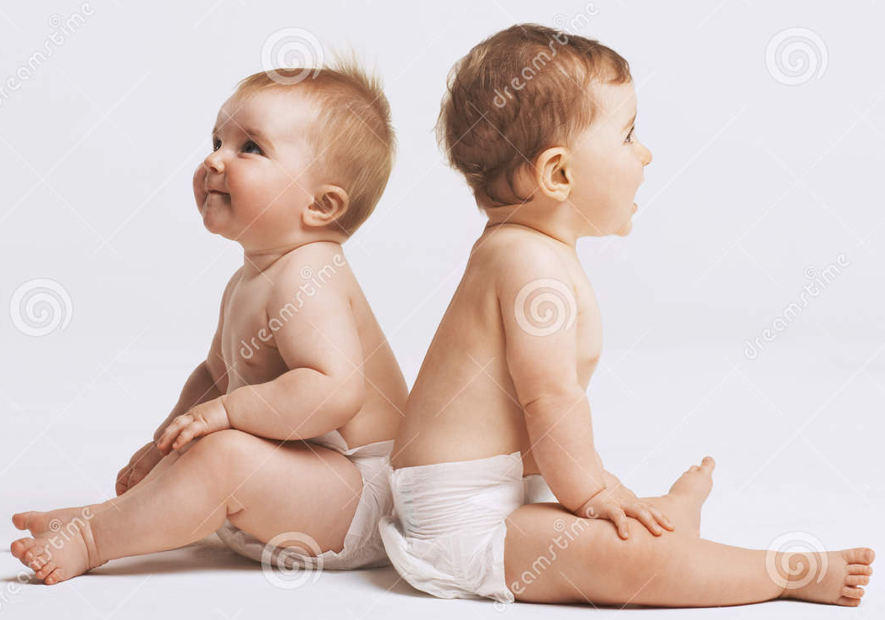
Gross motor
Raises head - 6-8wks
Head control 4m
Sits unsupported
(curved back) = 6m, (straight back) = 8m
Sits unsupported 9m
Crawls - 8-9m

Slide 7
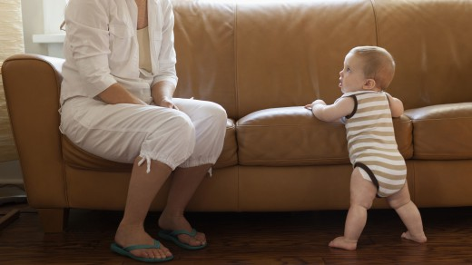
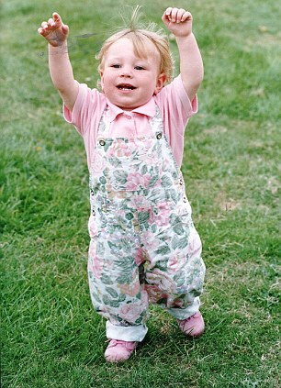
Gross motor
Cruises - 10m
Stands 12 m
Walks Unsteadily-12m, Steadily-15m
Walking 18m
Throws/Kicks ball - 18m-2yrs
Jumps – 3yrs

Slide 8
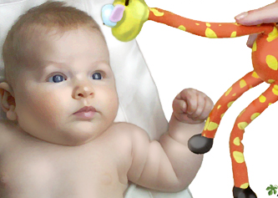
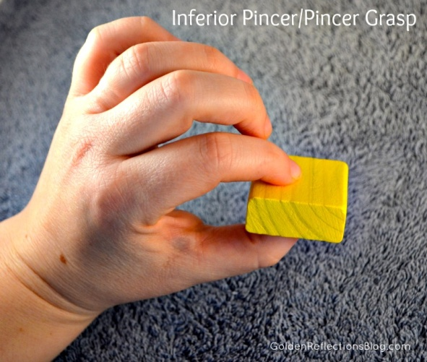
Fine motor and vision
Follows moving object - 6wks
Fixing and following 3m
Palmar grasp - 4-6m
Hand transfer – 7m
Hand transfer 9m
Pincer grip – 10m
Pincer grip 12m

Slide 9
Fine motor and vision
Drawing Skills
Makes marks with crayon 16-18m
Line 2yrs
Circle
3yrs
Cross
3 ½ yrs
Square
4yrs
Triangle
5yrs
Building Skills
Tower of 3
18m
Tower of 6
2yrs
Bridge
3yrs
Stairs
4yrs

Slide 10
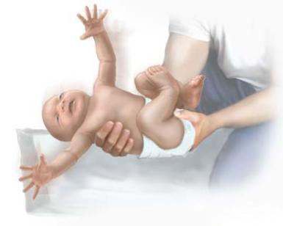
Hearing, Speech and language
Startles to loud noises – Newborn
Vocalises alone – 3-4m
Coos
Laughs
Turns to soft sounds out of sight – 7m
Non-specific babbling mama/dada – 7-10m
Specific mama/dada – 10m

Slide 11
Hearing, Speech and language
6-10 words (can identify 2 body parts when asked) – 18m
6 words with meaning by 18m
2-3 word phrases – 20-24m No more!
Joining words – 2yrs
Talks constantly in 3-4 word sentences – 2½-3yrs
Fluent speech – 4-5yrs
I want more sweets!!

Slide 12
Social, Emotional and Behavioural
Smiles responsively – 6wks
Puts food in mouth – 6-8m
Fear of strangers – 10m
Waves bye-bye and plays peek-a-boo – 10-12m
Drinks from cup with 2 hands – 12m

Slide 13
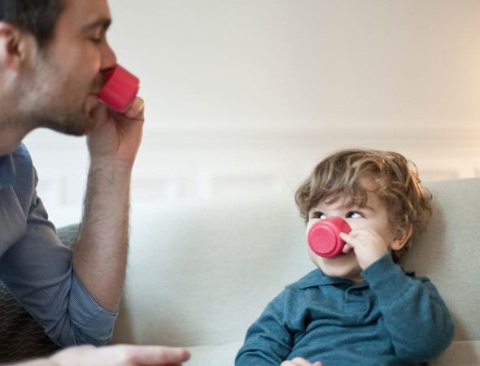
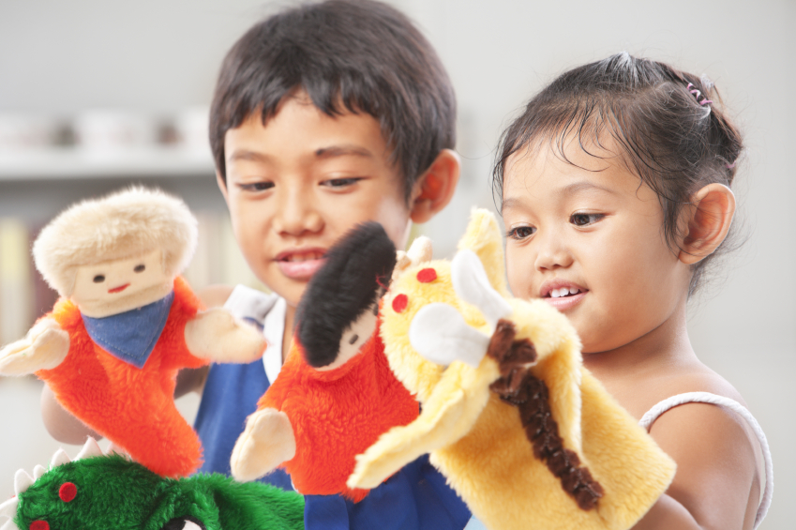
Social, Emotional and Behavioural
Feeds self using a spoon – 18m
Symbolic play – 18-24m
Symbolic play 2-2½yrs
Dry by day and
can undress – 2yrs
Parallel and interactive
play – 2½-3yrs

Slide 14
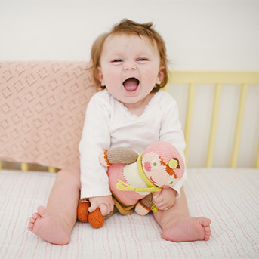
Preparation Advice
Put a picture together of the most advanced things a child at different ages should be able to do:
e.g. 8 months old
Sitting straight backed
Might be starting to crawl
Hand-to-hand transfer
Mama/Dada non-specific
Puts food in mouth

Slide 15
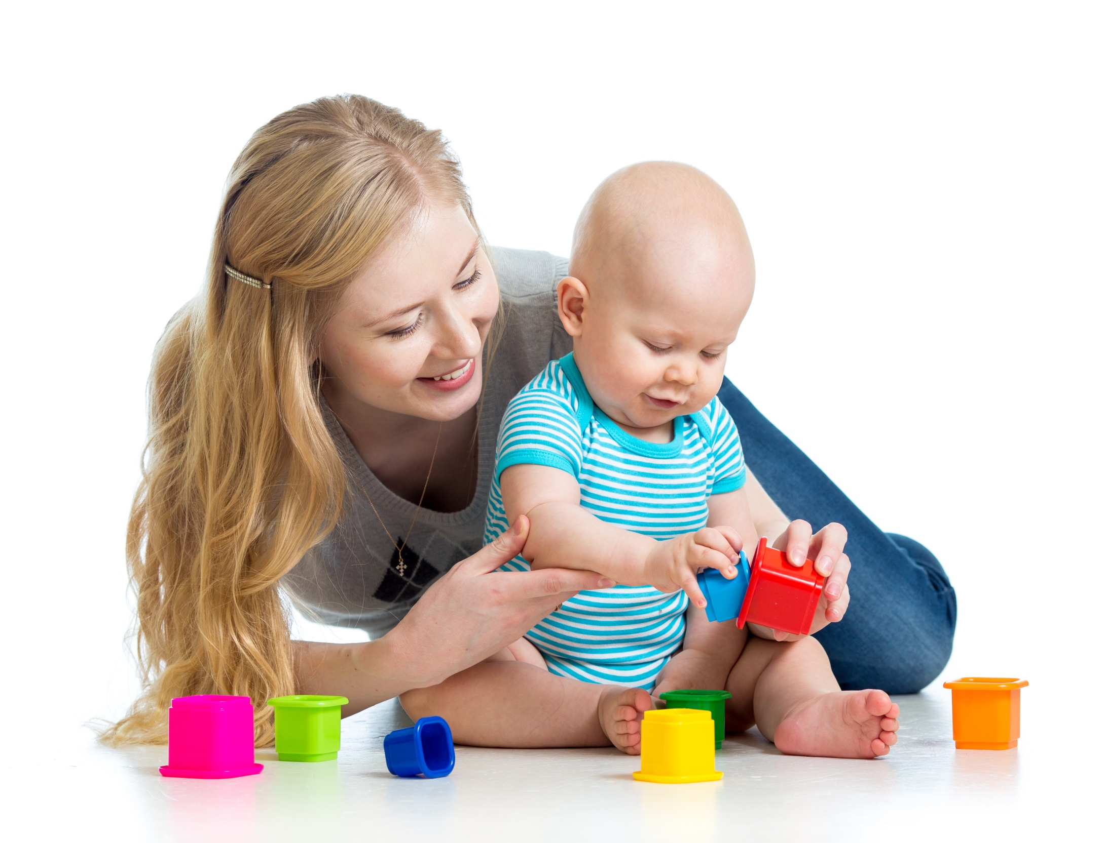
Now go and play!!!

Slide 16
Now go and play!!!
Introduce yourself to parent and child
Get down on the floor
Observe – dysmorphic features etc.
See what child can do
Ask parents about milestones
HAVE FUN!!!!

Slide 17
If it all goes wrong....

Slide 18
If it all goes wrong....
Don’t Panic!!
Hand screaming child back to parents
Ask the parents all of the things you would like have liked to demonstrate in the child

Slide 19
Enjoy! Any Questions?

