Slide 1
Paediatrics Revision Session Cardiology
Ellie Duckworth
Stage 3 student, University of Cambridge School of Clinical Medicine
18th April 2015

Slide 2
Cardiovascular Examination
General:
Make it fun!
Change how you act depending on their age
Introduction
Introduce yourself & check their name (& age)
Ask who they’ve brought with them (mum or dad)
Gain consent from both child & parents
Explain to the child (& parent) what you are doing throughout

Slide 3
Cardiovascular Examination
Focusing on differences to adult CV exam:
General inspection:
Dysmorphic features
Scars positioning:
midline sternotomy (ASD, VSD, cyanotic CHD)
left thoracotomy (PDA, coarctation)
Pulses:
Different normal ranges
Radio-femoral delay & radio-radial delay
Central capillary refill

Slide 4
Cardiovascular Examination
Palpate liver
Normally palpable 1-2cm below costal margin in infants,
Hepatomegaly (common sign of heart failure in infants)
Auscultation
Warm your stethoscope!
Left infraclavicular region (PDA)
Listen at the back (radiation from coarctation or pulmonary stenosis)
Normal sounds in young children – split 2nd heart sound (insp>exp), 3rd heart sound

Slide 5
Congenital Heart Disease
Acyanotic
Cyanotic
L → R shunt
Ventricular Septal Defect
Atrial Septal Defect
Patent Ductus Arteriosus
Obstructive lesion
Stenosis (aortic, pulmonary)
Coarctation of the aorta
Tetralogy of Fallot
Transposition of the great arteries
Complete atrioventricular septal defect
Hypoplastic left heart syndrome

Slide 6
Case 1
A 7 year old boy with a loud pansystolic murmur.
History:
Asymptomatic – murmur picked up incidentally
Examination:
Loud pansystolic murmur heard at the lower left sternal edge
Quiet pulmonary second sound (P₂)

Slide 7
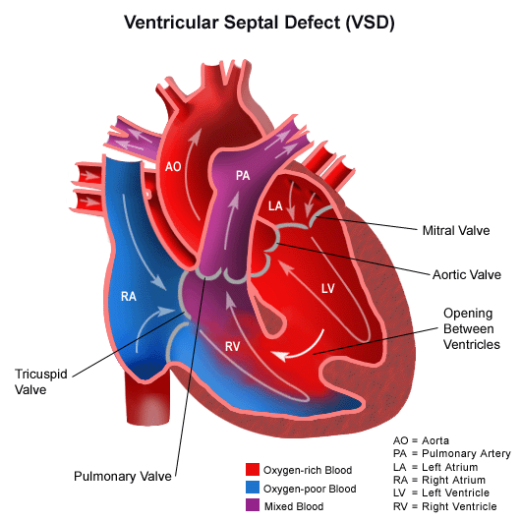
Ventricular Septal Defects (VSDs)
Most common form of congenital heart disease (30% of all cases of CHD)
Defect can be anywhere in the ventricular septum – perimembranous or muscular
www.stanfordchildrens.org

Slide 8
Small VSDs
Large VSDs
Symptoms:
Asymptomatic
Signs:
Loud pansystolic murmur at LLSE
Quiet P₂
Symptoms:
Presenting after 1 week old with:
Breathlessness
Failure to thrive
Recurrent chest infections
Signs:
Tachypnoea, tachycardia & enlarged liver due to heart failure
Soft pansystolic murmur at LLSE/no murmur
Apical mid-diastolic murmur
Loud P₂

Slide 9
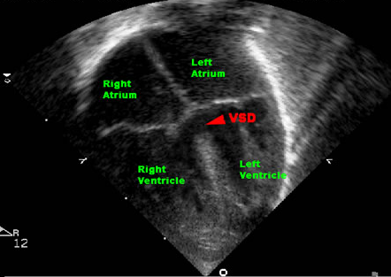
Small VSDs
Large VSDs
Investigations:
CXR – signs of heart failure
ECG – biventricular hypertrophy (by 2 months old)
Echo – shows size, haemodynamic effects & pulmonary hypertension
Management
Medical – diuretics often combined with captopril
Surgical
usually done at 3-6 months old
prevent permanent damage to pulmonary capillary vascular bed
Investigations:
CXR & ECG normal
Echocardiography to assess size of defect
Doppler to assess haemodynamic effects
Management
Monitor – small VSDs will close spontaneously
www.kkh.com.sg

Slide 10
Case 2
6 week old baby with a murmur picked up on a routine 6 week baby check
Otherwise well.
Examination
Collapsing pulse
Continuous ‘machinery’ murmur below left clavicle

Slide 11
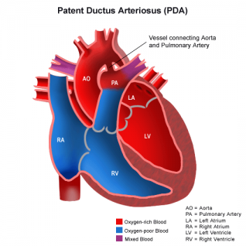
Patent Ductus Arteriosus (PDA)
2nd most common congenital heart disease (12%)
Definition: ductus arteriosus has failed to close by 1 month after EDD
www.stanfordchildrens.org

Slide 12
Patent Ductus Arteriosus (PDA)
History
Usually asymptomatic
A large duct may cause symptoms of heart failure
Examination
Collapsing pulse
Continuous ‘machinery’ murmur below the left clavicle
Displaced apex
Notes:
Symptoms of heart failure – breathlessness, failure to thrive,

Slide 13
Patent Ductus Arteriosus
Investigations
CXR & ECG usually normal
Echo shows size of duct
Management
Treatment at 1 year old
Cardiac catheter with coil or occlusion device
Surgical ligation
Neo Reviews

Slide 14
Case 3
A 3 year old girl presents to the GP with recurrent chest infections.
History:
Recurrent chest infections & wheeze
Otherwise well
Examination:
Ejection systolic murmur in the pulmonary area
Fixed and widely split 2nd heart sound

Slide 15
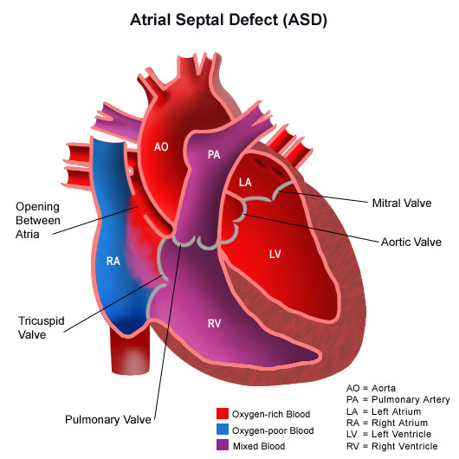
Atrial Septal Defects (ASDs)
Much less common (7% of all CHD)
2 main types:
Ostium secundum (80% of ASDs)
Ostium primum
www.stanfordchildrens.org

Slide 16
Atrial Septal Defects (ASDs)
History
Often asymptomatic
Heart failure
Recurrent chest infections/ wheeze
Growth impaired
(Arrhythmias seen aged 30+)
Examination
Ejection systolic murmur in pulmonary area
Fixed splitting of 2nd heart sound
Mid-diastolic murmur in tricuspid region

Slide 17
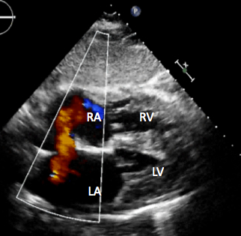
Atrial Septal Defects
Investigations
CXR – signs of heart failure
ECG – partial right bundle branch block
Echo & Doppler
Management
Depends on size & location
Cardiac catherisation with occlusion device
Surgical correction
Treatment aged 3-5
123sonography.com

Slide 18
Case 4
2 day old baby is rushed into A&E with acute circulatory collapse
Previously normal newborn baby check
Examination
Signs of severe heart failure
Absent femoral pulses
Metabolic acidosis

Slide 19
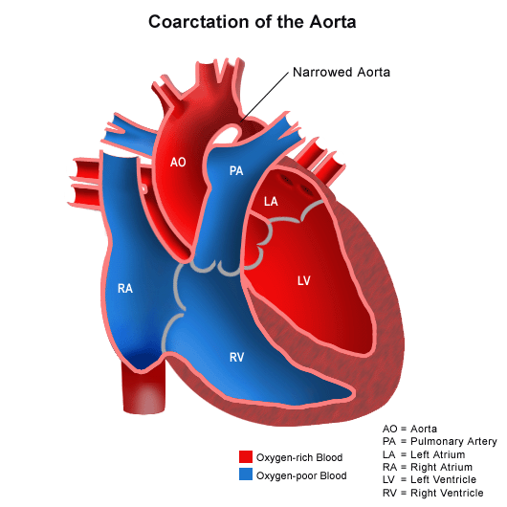
Coarctation of the aorta
Only 5% of congenital heart defects
Caused by ductus arteriosus tissue encircling the aorta
When the duct closes, the aorta becomes constricted
www.stanfordchildrens.org

Slide 20
Coarctation of the aorta
Pre-ductal coarctation
Post-ductal coarctation
Usually identified antenatally
Symptomatic
No symptoms at birth
Present at 2 days old with sudden circulatory collapse
Examination
Absent femoral pulses
Radio-femoral delay
No murmur
Management
Prostaglandins
Transfer to cardiac centre for surgery
Usually asymptomatic
Sometimes leg pains or headaches
Examination
Hypertension in upper limbs
Weak/absent femoral pulses
Ejection click (Bicuspid aortic valve)
Ejection systolic murmur in left interscapular area
Investigations
CXR - rib notching in teenagers & adults
Management
Surgery – balloon dilatation or resection of coarcted segment

Slide 21
Tetralogy of Fallot
Only 5% of all CHDs
4 features:
VSD
Overriding aorta
Pulmonary stenosis
Right ventricular hypertrophy
www.stanfordchildrens.org

Slide 22
Tetralogy of Fallot
Usually diagnosed antenatally
History
Cyanosis in first 1-2 months
Hypoxic spells – hypercyanotic, irritable, breathlessness & pallor
Squatting on exercise in late infancy
Examination
Clubbing
Ejection systolic murmur in pulmonary area
Loud S2

Slide 23
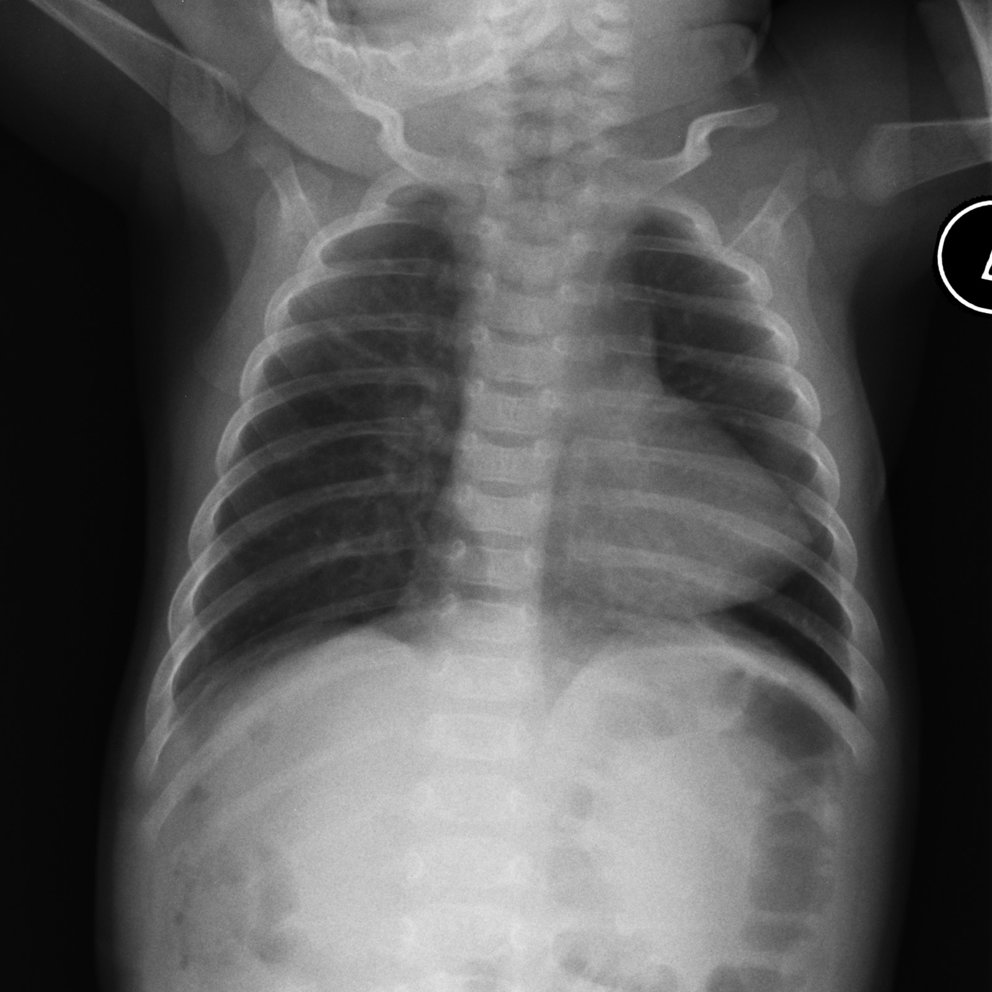
Tetralogy of Fallot
Investigations
CXR
small, ‘boot-shaped’ heart
Pulmonary artery ‘bay’
ECG – right ventricular hypertrophy (older children)
Management
Initially medical management of hypercyanotic spells
Corrective surgery at 4-6 months
Radiopaedia.org

Slide 24
Transposition of the Great Arteries
Only 5% of all CHDs
2 parallel circuits
Aorta connected to the right ventricle
pulmonary artery connected to the left ventricle
Present at 2 days old with severe cyanosis due to closure of the duct
Management
Prostaglandins to maintain duct
Surgery - balloon atrial septostomy, arterial switch procedure
www.stanfordchildrens.org

Slide 25
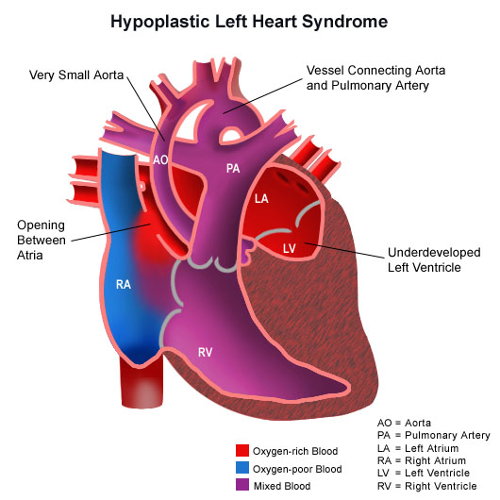
Hypoplastic Left Heart Syndrome
Underdevelopment of the entire left side of the heart
Duct dependent – any constriction leads to severe acidosis and cardiovascular collapse
Surgical management with at least 3 complex procedures
www.stanfordchildrens.org

Slide 26
Questions?

